Slide 1
Application Delivery Fundamentals 2.0
Spring Core Annotations
Notes:
Faculty Notes:
Introduce yourself, if necessary.
Introduce the module and time frame, which is approximately 1.5 hours
Verify the students have the proper handouts for the module.
Ensure the students have access to the required software for the practice exercises.
Participant Notes:
N/A

Slide 2
Course Goals / Objectives
At the end of this module, participants will be able to:
Spring annotations
Annotation Configuration
@Autowired
@Component
@Qualiifier
Java Based Configuration Annotation
@Configuration
@Bean
Sample Code
Activity

Slide 3

Agenda
This module will cover the following topics:
Some of the Spring Annotations
XML Configuration & Annotations
Java Based Configurations
When use what?
Summary

Slide 4
How Spring works
Your Application Classes (POJOs)
Spring
Application Context
applicationContext.xml
/
Module-servlet.xml
Configuration
Instructions
Creates
Fully configured
application system
Ready for use
Notes:
Just introduce the way people are used to configuring application.

Slide 5
Bean Injection
public class TransferServiceImpl implements
TransferService {
// Constructor Injection
public TransferServiceImpl(AccountRepository ar) {
this.accountRepository = ar;
}
…
// OR – Setter Injection
AccountRepository accountRepository;
public setAccountRepository (AccountRepository ar) {
this.accountRepository = ar;
}
}
Injecting AccountRepository Bean to
TransferServiceImpl
Notes:
Just introduce the way people are used to configuring application.
5

Slide 6
Constructor Injection – XML Configuration
<beans>
<bean id=“transferService” class=“app.impl.TransferServiceImpl”>
<constructor-arg ref=“accountRepository” />
</bean>
<bean id=“accountRepository” class=“app.impl.JdbcAccountRepository”>
<constructor-arg ref=“dataSource” />
</bean>
<bean id=“dataSource” class=“com.mysql.jdbc.Driver”>
<property name=“URL” value=“jdbc:mysql://localhost:3306/codingtondb” />
<property name=“user” value=“root” />
<property name=“password” value=“abcd1234” />
</bean>
</beans>
Constructor Injection
Constructor Injection
Constructor Injection
Notes:
XML Configuration required to Inject a Spring Bean through Constructor.
6

Slide 7
Setter Injection – XML Configuration
<beans>
<bean id=“transferService” class=“app.impl.TransferServiceImpl”>
<property name=“accountRepository” ref=“accountRepository” />
</bean>
<bean id=“accountRepository” class=“app.impl.JdbcAccountRepository”>
<property name=“dataSource” ref=“dataSource” />
</bean>
<bean id=“dataSource” class=“com.mysql.jdbc.Driver”>
<property name=“URL” value=“jdbc:mysql://localhost:3306/codingtondb” />
<property name=“user” value=“root” />
<property name=“password” value=“abcd1234” />
</bean>
</beans>
Place holder (Setter – Getter methods) for injecting bean in parent class.
S
e
t
t
e
r
I
n
j
e
c
t
i
o
n
Notes:
Explain the Setter injection and placeholder (setter / getter methods) for the injecting bean in the parent class.
7

Slide 8
@Autowired
public class TransferServiceImpl implements TransferService {
@Autowired
public TransferServiceImpl(AccountRepository ar) {
this.accountRepository = ar;
}
…
}
public class JdbcAccountRepository implements AccountRepository {
@Autowired
public JdbcAccountRepository(DataSource ds) {
this.dataSource = ds;
}
…
}
Notes:
Explain @Autowired annotation
8

Slide 9
@Autowired – XML Configuration
<beans>
<bean id=“transferService” class=“app.impl.TransferServiceImpl” />
<bean id=“accountRepository” class=“app.impl.JdbcAccountRepository” />
<bean id=“dataSource” class=“com.mysql.jdbc.Driver”>
<property name=“URL” value=“jdbc:mysql://localhost:3306/codingtondb” />
<property name=“user” value=“root” />
<property name=“password” value=“abcd1234” />
</bean>
<context:annotation-config/>
</beans>
No need to specify
constructor-args / Setter reference
looks for annotations on beans
only in the same application context
where it is defined
Notes:
XML Configuration required for @Autowired and . <context:annotation-config/>
9

Slide 10
@Autowired contd…
@Autowired annotation can be applied on setter methods, constructors and fields.
Autowired indicating “required dependencies”.
Autowire will fail if no matching bean is available in the context.
@Autowired(required=false) – indicating not a mandatory dependency. Defaults to true. Autowire will not fail if no matching bean is available in the context.
@Autowired(required=false)
private AccountRepository accountRepository;

Slide 11
@Component
Indicates that the annotated class is a "component"
Both identify POJOs as Spring Beans
Removes the need to specify almost anything in XML
Optionally pass it a String, which will be the bean name
Default bean name is de-capitalized non-qualified name
@Component
public class TransferServiceImpl implements TransferService
public TransferServiceImpl(AccountRepository ar) {
this.accountRepository = ar;
}
…
}

Slide 12
@Component contd…
@Component takes a String parameter that names the bean
Arguably not a best practice to put bean names in your Java code
<context:component-scan base-package="com.accenture.xx.xx.x" /> - required in configuration xml to enable annotation scan in mentioned package
@Component(“myTransferService”)
public class TransferServiceImpl implements TransferService
public TransferServiceImpl(AccountRepository ar) {
this.accountRepository = ar;
} …
}

Slide 13
@Qualifier
To used on a field or parameter as a qualifier for a beans when autowiring
Can be used in other annotations to that can be used as qulaifier
Needed in case multiple instances of the same type exist, one of which needs to be autowired
Using an @Qualifier annotation you can inject named beans
Specify the bean name of the
bean you want to inject
@Autowired
@Qualifier(“primaryDataSource”)
private DataSource dataSource;

Slide 14
When to use What
Start using annotations for small isolated parts of your application (Spring @MVC controllers)
Annotations are spread across your code base
XML is centralized in one (or a few) places
XML for infrastructure and more 'static' beans
Annotations for frequently changing beans

Slide 15
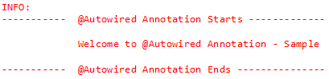
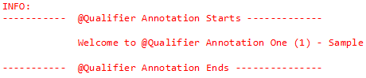
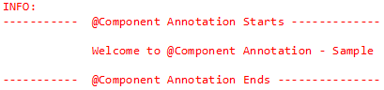
Spring Core Annotations : See-It
Demonstration :
Faculty will demonstrate annotations @Autowired, @Qualifier and @Component
Environment : applicationContext.xml and all files in com.accenture.adfx.module2.sample
Duration: 20 min
Steps:
Open ADFExtensionCodebaseM2SpringCoreAnnotation_participant
Open folder com.accenture.adfx.module2.sample
Run the following files one by one and check the logs
AutowiredSampleClient.java (log 2a)
QualifierSampleClient.java (log 2b)
ComponentSampleClient.java (log 2c)
Refer to their respective main and impl classes too along with applicationContext.xml
2a
2b
2c
2a

Slide 16
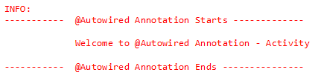
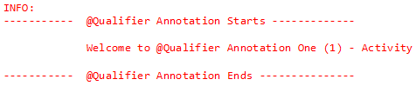
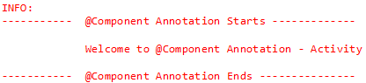
Spring Core Annotations : Try It
Time Allocated: 30 minutes
Environment - Eclipse
Steps:
Open ADFExtensionCodebaseM2SpringCoreAnnotation_participant
Open folder com.accenture.adfx.module2.activity
Complete
TODO 1 – TODO4 in applicationContext.xml
TODO 1 in AutowiredActivityMain.java
TODO 1 – TODO3 in AutowiredActivityClient.java
TODO 1 in ComponentActivityMain.java
TODO 1 – TODO3 in ComponentActivityClient.java
TODO 1 in QualifierActivityMain.java
TODO 1 – TODO3 in QualifierActivityClient.java

Slide 17
Java Based Annotations
Enables us to write most of the configurations without using XML.
Uses Annotations instead of XML
Commonly used annotations are:
@Configuration
@Bean
@Import
@Primary
@Lazy

Slide 18
@Configuration and @Bean
Class level annotation that defines a class as a source of bean definitions.
Uses @Bean annotation to identify a POJO as a Spring Bean
@Configuration
public class MyConfiguration{
@Bean
public TestBean testBean(){
return new TestBean();
}
}
Code is equal to the following XML Declaration
<beans>
<bean id =“testBean” class=“com.beans.TestBean/>
</beans>

Slide 19
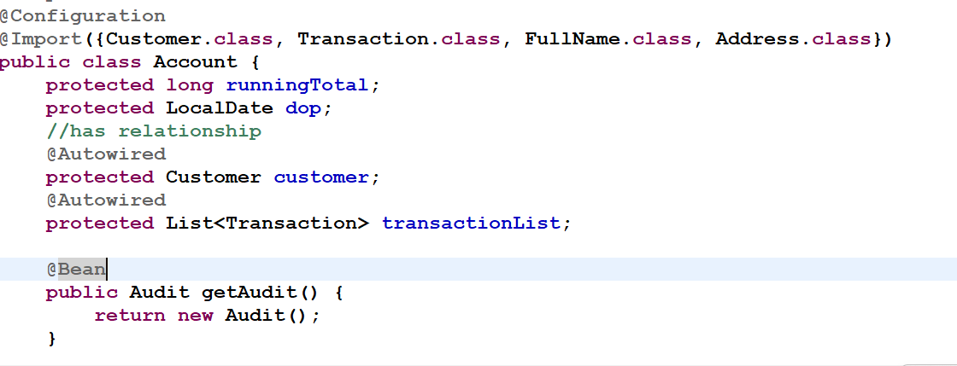
@Import
@Import annotation is used for importing beans defined in some other Configuration class.
Example using AnnotationApplicationContext

Slide 20
@Primary
In the same application context, if multiple beans are qualified to autowire a single dependency, we might require to give one bean a preference over other beans.
@Primary is used for the same!!!
@Primary has no effect until component-scan is used.

Slide 21
@Primary – Example (Contd..)
@Component
public class InvoiceService{
private InvoiceRepository invRepository;
@Autowired
public InvoiceService(InvoiceRepository invRepository)
{
this.invRepository = invRepository.
}
}
@Component
Public class JDBCRepository
{
…
}

Slide 22
@Primary - Example
@Component
@Primary
Public class HibernateRepository { … }
In the above example, since HibernateRepository is annotated with @Primary, Spring will automatically inject this repository over other similar beans equally qualified.

Slide 23
@Lazy
Indicates whether a bean is to be lazily initalized.
Used on class directly or indirectly annotated with @Component or on methods annotated with @Bean
By default bean initialization is eager unless specified explicitly as lazy.

Slide 24
Overview
@Component, so the functionality is the same as we have discussed for @Component, but we annotate classes that are services in the application
@Repository it is a @Component, but we annotate classes that are repositories, so we have the database-related operations in these classes
@Bean it is used to explicitly declare a single bean, rather than letting the framework do it automatically with scanning

Slide 25
Overview
@Autowire this is how we inject a dependency, we do not have to instantiate the class with the ’new’ keyword, it is handler by the framework itself
@Qualitfier there may be a situation when you create more than one bean of the same type and want to wire only one of them with a property, in such case you can use @Qualifier annotation along with @Autowired to remove the confusion by specifying which exact bean will be wired

Slide 26
Overview
@Configuration it is a @Component as well. Indicates that the given class declares one or more @Bean methods. It indicates also that the class may be processed by the Spring container to generate bean definitions and service requests for those beans at runtime
@ComponentScan Spring container can detect and register the beans and the classes with the @Component annotation ( as well as the @Services and @Repositorys ). We can define the package name in which Spring is going to scan for the components.

Slide 27
Overview
@EnableAutoConfiguration auto-configures the beans that are present in the classpath. For example, if we have tomcat-embedded.jar in the classpath, we need the Tomcat Embedded ServletContainer Factory bean to configure the tomcat server. This will be done because of this annotation

Slide 28
Overview
@SpringBootApplication because most of the applications needs the @Configuration, @ComponentScan and the @EnableAutoConfiguration annotations, they have been merged into this single @EnableAutoConfiguration annotation

Slide 29
Additional Resources
Additional Links :
http://static.springsource.org/spring/docs/2.5.x/api/org/springframework/beans/factory/annotation/

Slide 30
Course / Module Summary
Fill in the blanks to complete Module Summary
@Autowired annotation can be applied on _____________, ___________ and _______.
Using an ___________annotation you can inject named beans.
____________ annotation takes a String parameter that names the bean
Notes:
@Autowired annotation can be applied on setter methods , constructors and fields.
Using an @Qualifier annotation you can inject named beans
@Component annotation takes a String parameter that names the bean

Slide 31
Course / Module Summary
Fill in the blanks to complete Module Summary
@Autowired annotation can be applied on setter methods, constructors and fields.
Using an @Qualifier annotation you can inject named beans.
@Component annotation takes a String parameter that names the bean
Notes:
@Autowired annotation can be applied on setter methods , constructors and fields.
Using an @Qualifier annotation you can inject named beans
@Component annotation takes a String parameter that names the bean

Slide 32
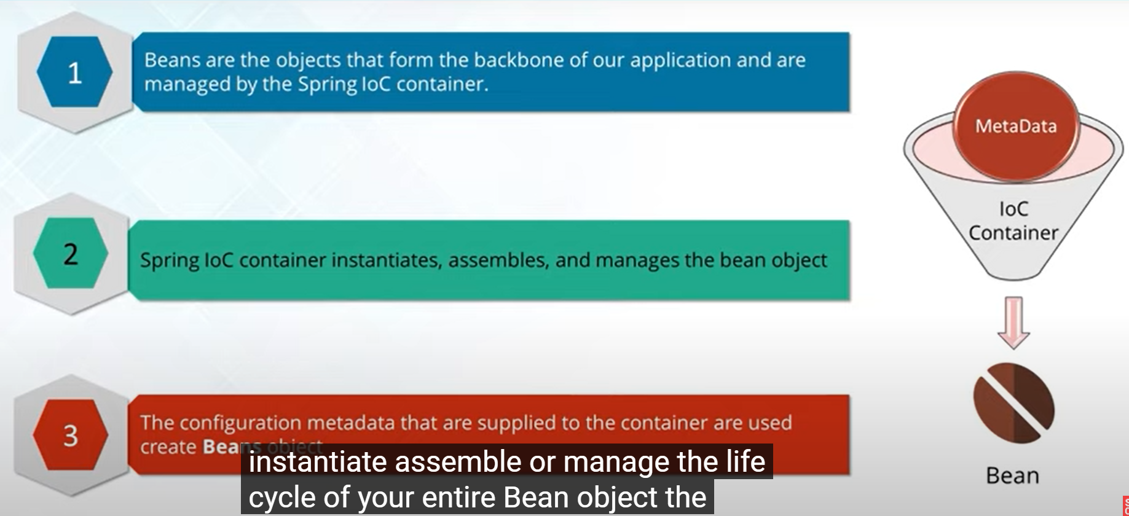
Bean

Slide 33
Bean Scope
Singleton: It will create single instance per Ioc container.
request: This will be there for a single HTTP request.
session: This will be valid for an HTTP session.
prototype: Bean can have any number of objects.
global-session: This will be valid for global HTTP session.

Slide 34
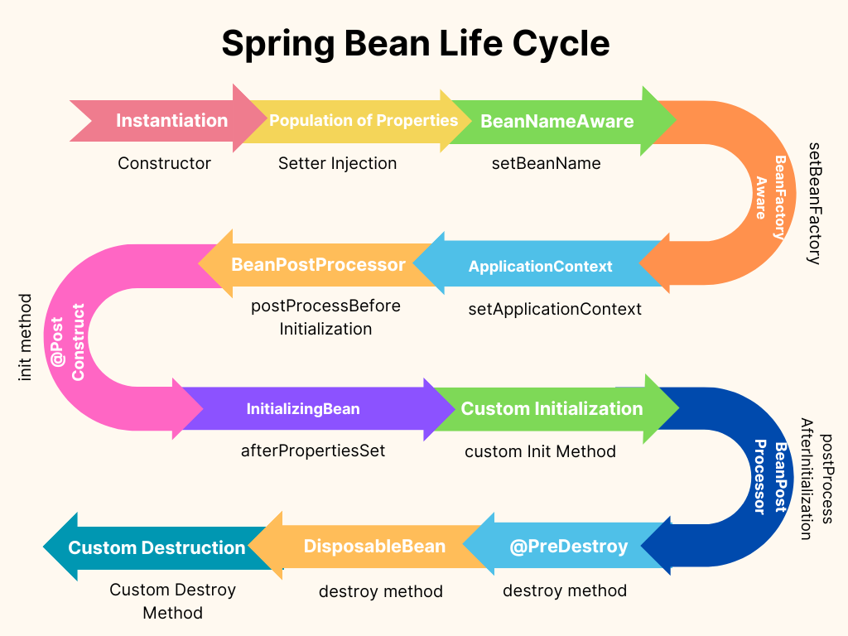
Spring Lifecycle

Slide 35
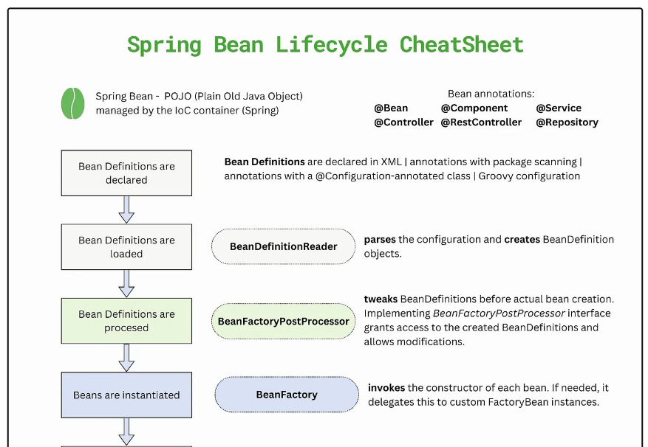
Spring Lifecycle

Slide 36
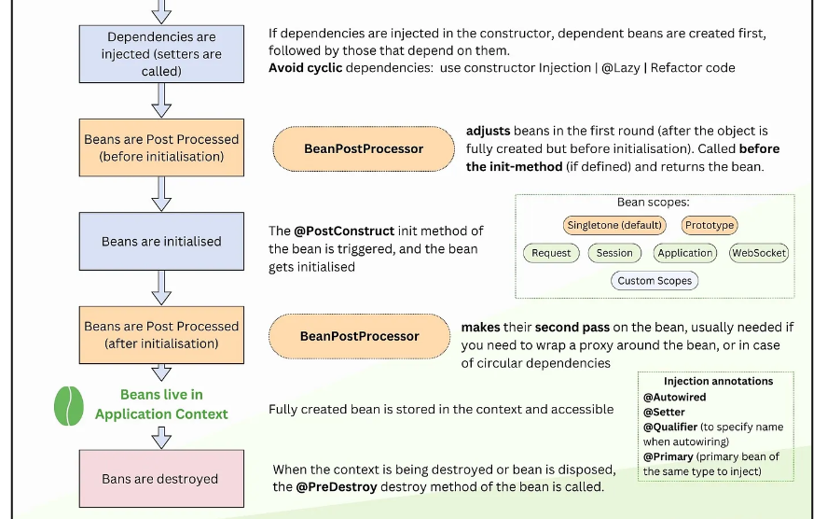
Spring Lifecycle

Slide 37
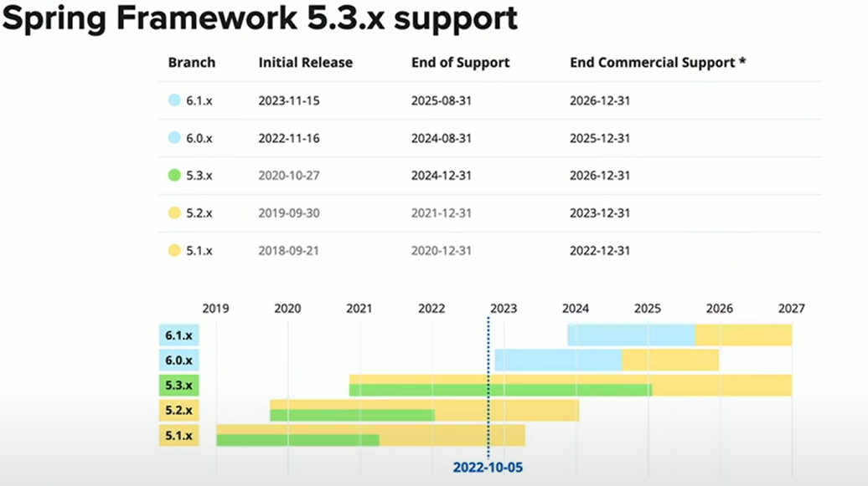
Spring Versions and Features

Slide 38
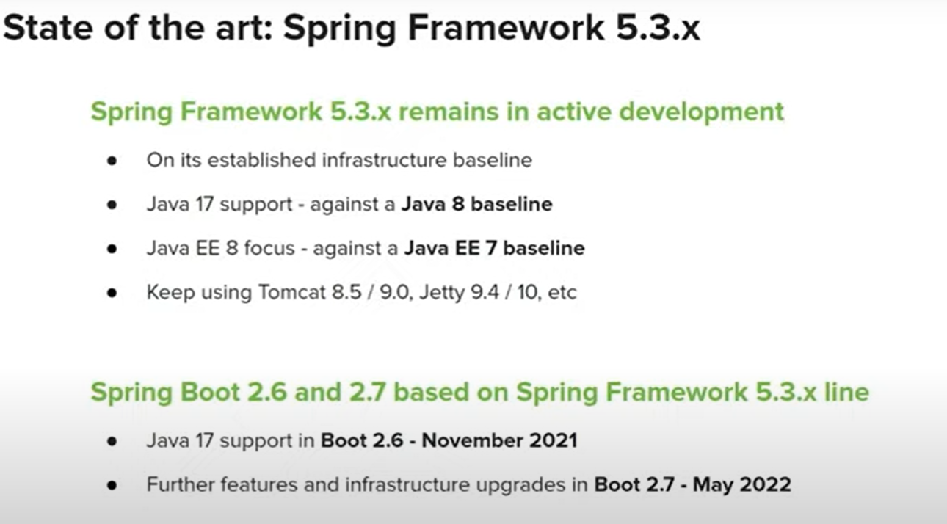
Spring Versions and Features

Slide 39
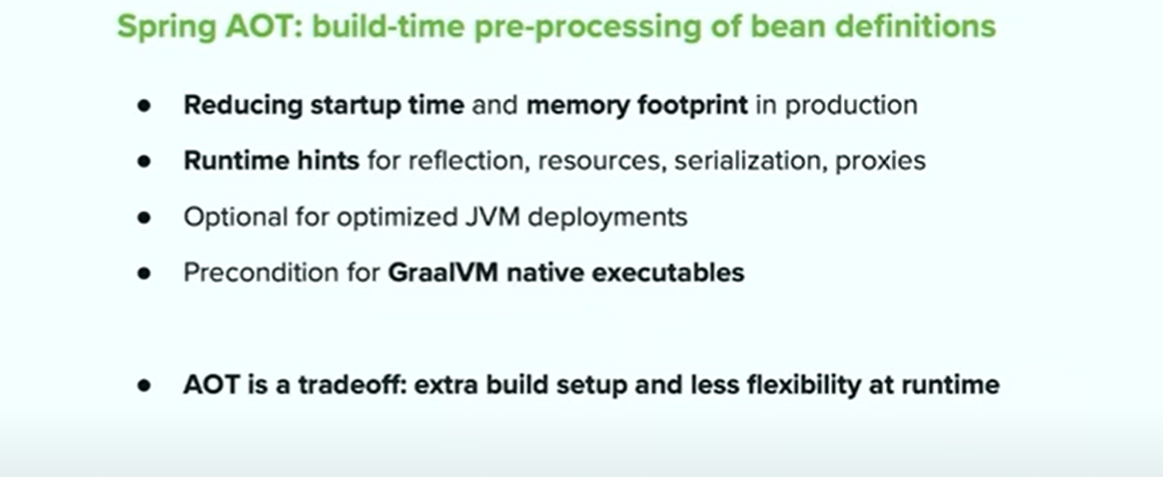
Spring Versions and Features

Slide 40
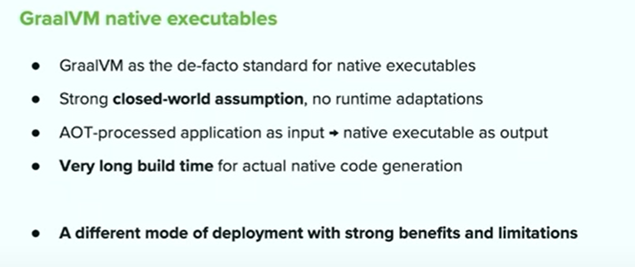
Spring Versions and Features

Slide 41
Graalvm
GraalVM is a high-performance JDK built specifically with cloud native applications in mind.
It is used for its optimized compiler and generating Java code faster.
Developers can choose to incorporate GraalVM in their Java tech stack to enable faster startups, lower resource usage, improved security, and compact packaging.
The key to faster startups are the compilers: the ahead-of-time (AOT) compiler and the just-in-time (JIT) compiler.

Slide 42
Graalvm
The first production-ready version of GraalVM was released in May 2019; the current version, GraalVM 23.0.0, was released in June 2023.
The paid version, Oracle GraalVM Enterprise Edition, is based on the Oracle JDK, whereas the free version, GraalVM Community Edition, is based on the Open JDK.

Slide 43
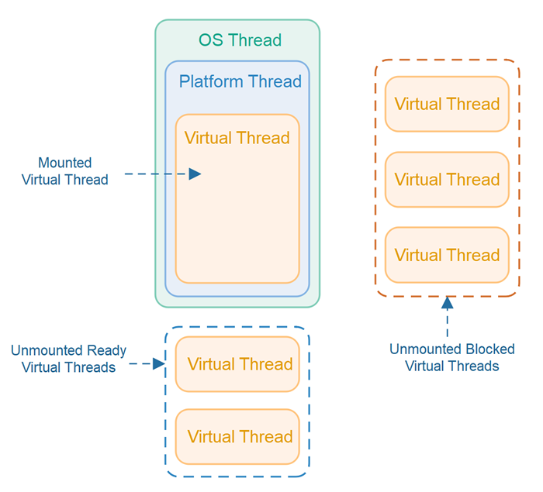
Virtual Thread

Slide 44
Course / Module Summary
Now that you have completed this module, you should be familiar with the following concepts:
Spring’s configuration directives can be written in XML or using annotations
You can mix and match XML and annotations as you please
@Autowired and @Component allow for almost empty configuration files

Slide 45
Questions

